Slide 1

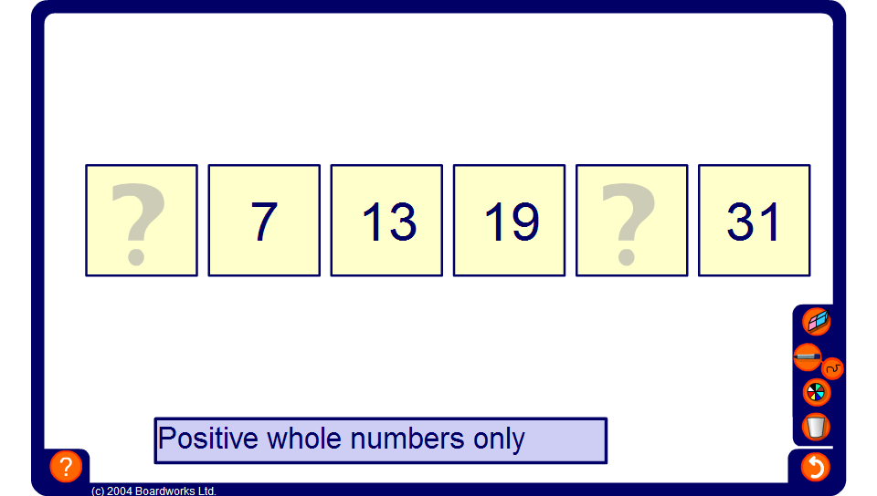


Finding missing terms
Notes:
Discuss strategies for finding the missing terms in each linear sequence.

